Slide 1
Lesson 16
Propulsion, Launch Systems, and Mission Operations

Slide 2
Propulsion

Slide 3

S/C Propulsion Functions
Provide $ΔV$ for:
Attitude control
Momentum dumping
Orbit maintenance
Maneuvers

Slide 4
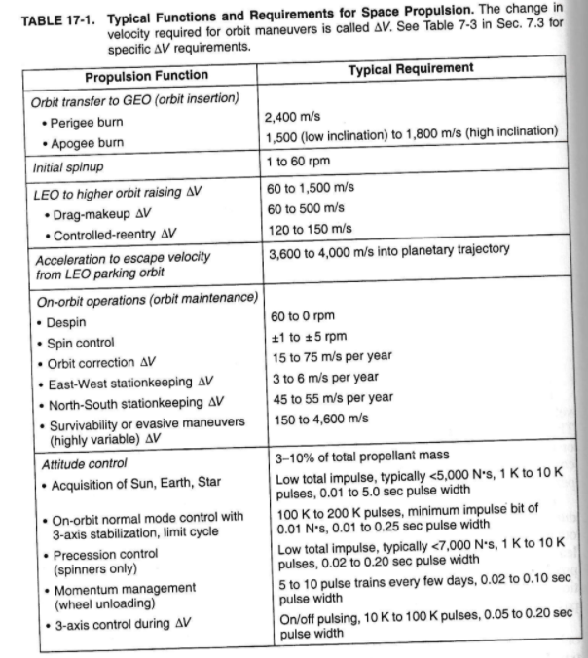

Slide 5
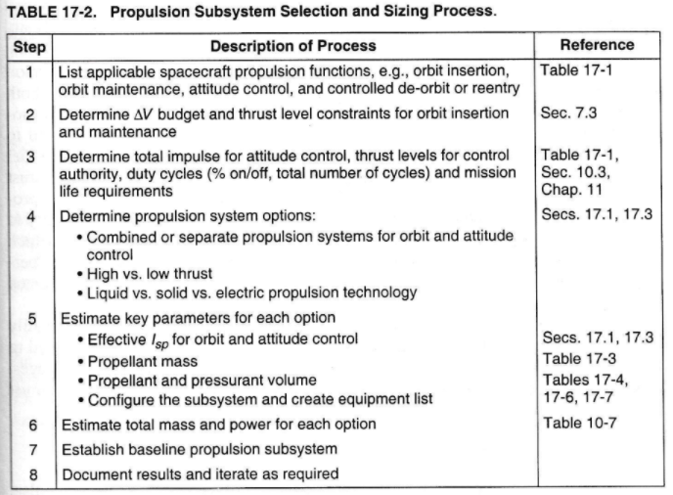

Slide 6
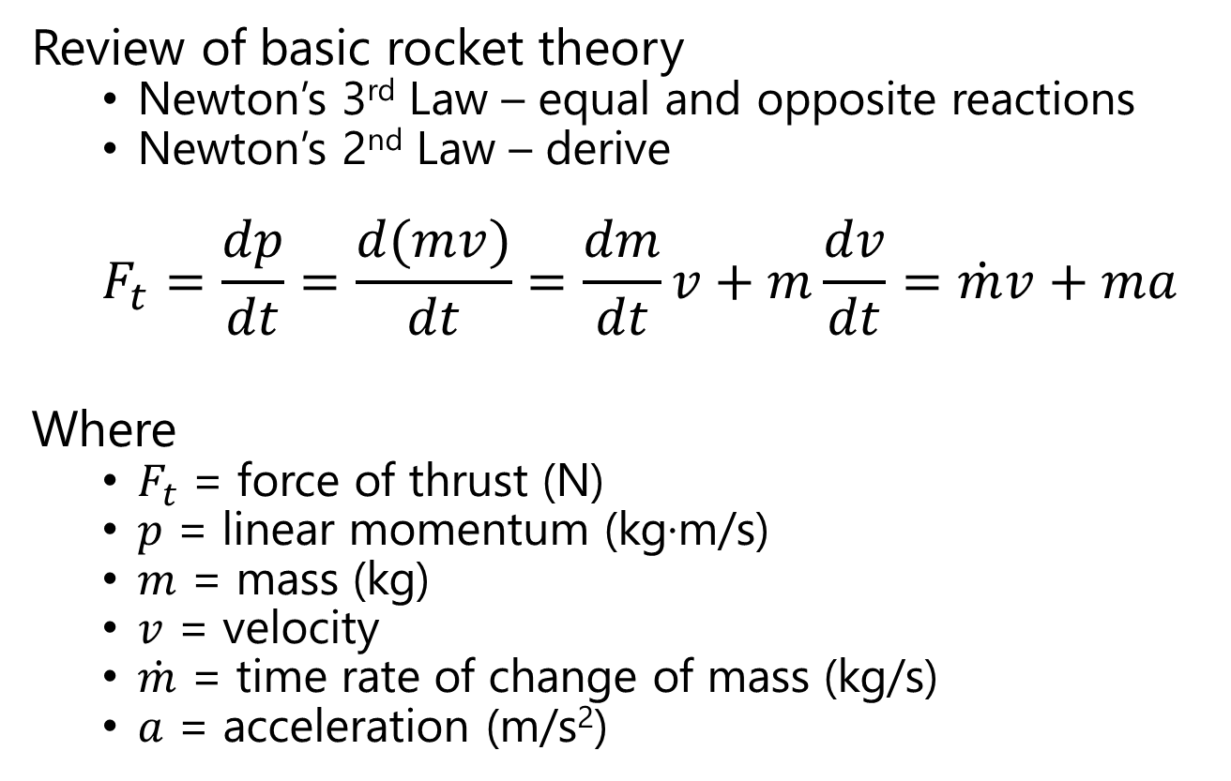
Ideal Rocket Eqn (and its variants)
Review of basic rocket theory
Newton’s 3rd Law – equal and opposite reactions
Newton’s 2nd Law – derive
$$F_{t}=\frac{dp}{dt}=\frac{d(mv)}{dt}=\frac{dm}{dt}v+m\frac{dv}{dt}=\dot{m}v+ma$$
Where
$F_{t}$ = force of thrust (N)
$p$ = linear momentum (kg·m/s)
$m$ = mass (kg)
$v$ = velocity
$\dot{m}$ = time rate of change of mass (kg/s)
$a$ = acceleration (m/s²)

Slide 7
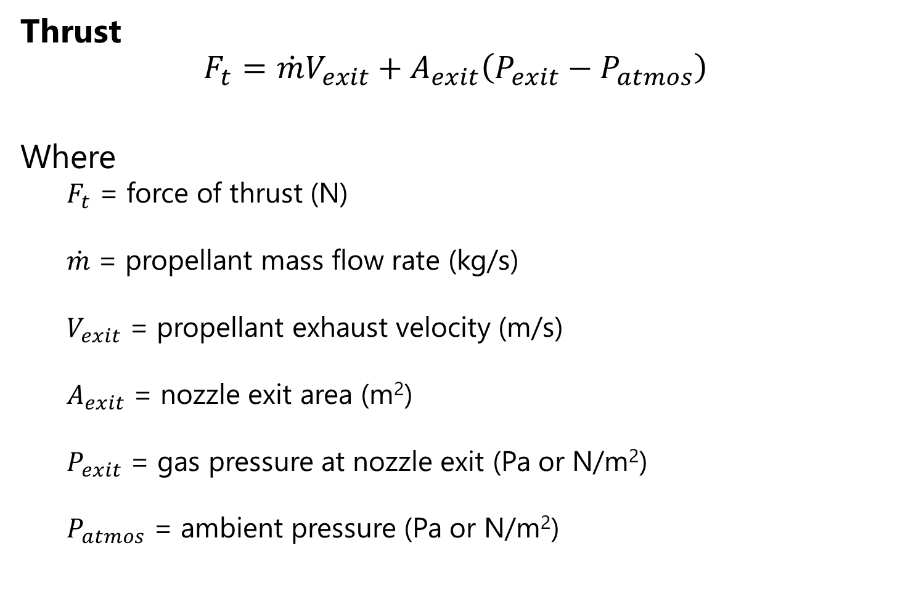
Basic Parameters of Rocket Design (1/2)
Thrust
$$F_{t}=\dot{m}V_{exit}+A_{exit}\left(P_{exit}−P_{atmos}\right)$$
Where
$F_{t}$ = force of thrust (N)
$\dot{m}$ = propellant mass flow rate (kg/s)
$V_{exit}$ = propellant exhaust velocity (m/s)
$A_{exit}$ = nozzle exit area (m²)
$P_{exit}$ = gas pressure at nozzle exit (Pa or N/m²)
$P_{atmos}$ = ambient pressure (Pa or N/m²)

Slide 8
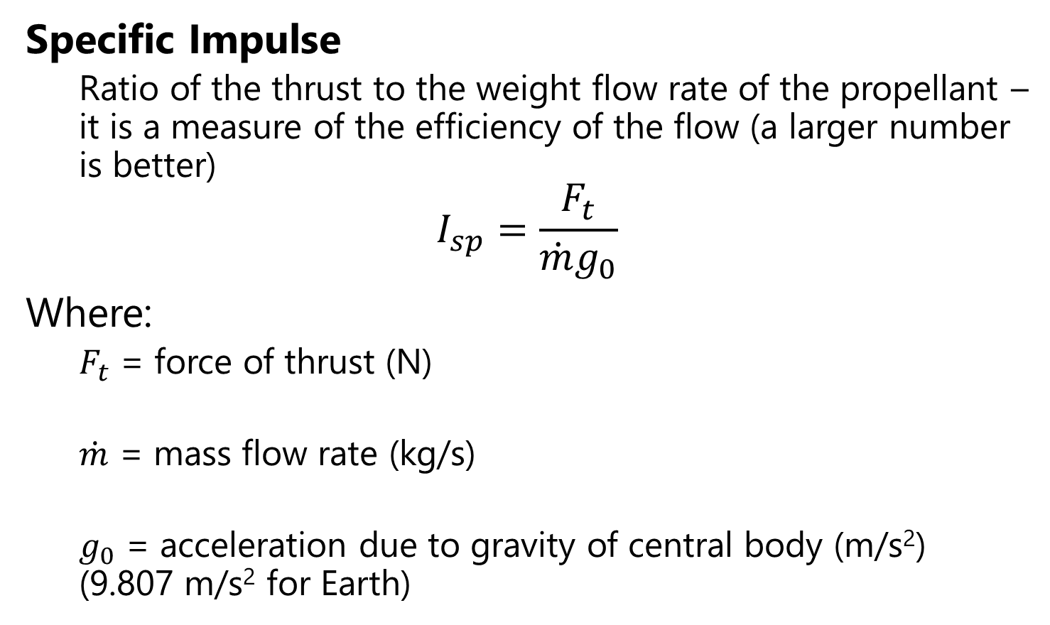
Basic Parameters of Rocket Design (2/2)
Specific Impulse
Ratio of the thrust to the weight flow rate of the propellant – it is a measure of the efficiency of the flow (a larger number is better)
$$I_{sp}=\frac{F_{t}}{\dot{m}g_{0}}$$
Where:
$F_{t}$ = force of thrust (N)
$\dot{m}$ = mass flow rate (kg/s)
$g_{0}$ = acceleration due to gravity of central body (m/s²) (9.807 m/s² for Earth)

Slide 9
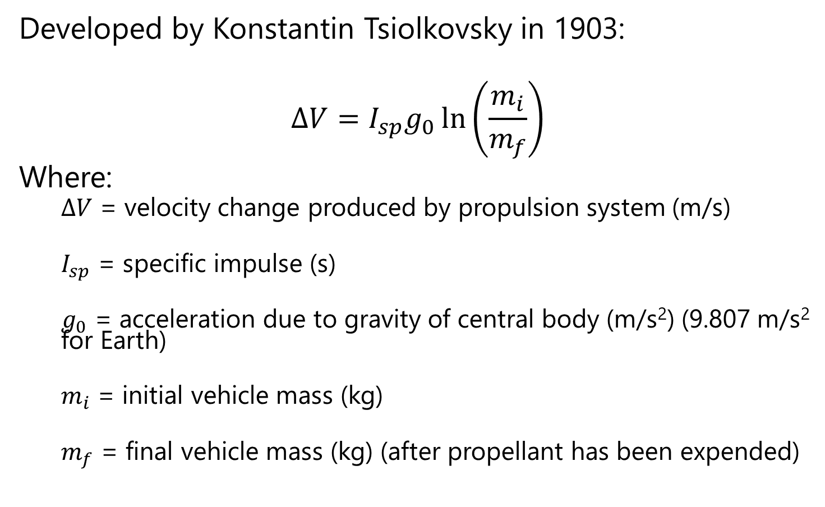
Ideal Rocket Equation
Developed by Konstantin Tsiolkovsky in 1903:
$$ΔV=I_{sp}g_{0}\ln\left(\frac{m_{i}}{m_{f}}\right)$$
Where:
$ΔV$ = velocity change produced by propulsion system (m/s)
$I_{sp}$ = specific impulse (s)
$g_{0}$ = acceleration due to gravity of central body (m/s²) (9.807 m/s² for Earth)
$m_{i}$ = initial vehicle mass (kg)
$m_{f}$ = final vehicle mass (kg) (after propellant has been expended)

Slide 10
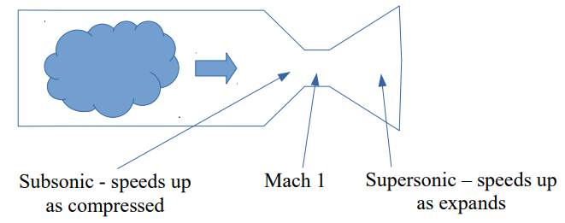
Classic Rocket Engine
Note that we achieve greatest thrust when exit pressure = ambient pressure
Although it looks like thrust would be greater with exit pressure greater than ambient pressure, the exhaust velocity is reduced, resulting in a loss of thrust
Thus, we design rocket exhaust nozzles with an exit pressure equal to ambient pressure whenever possible

Slide 11
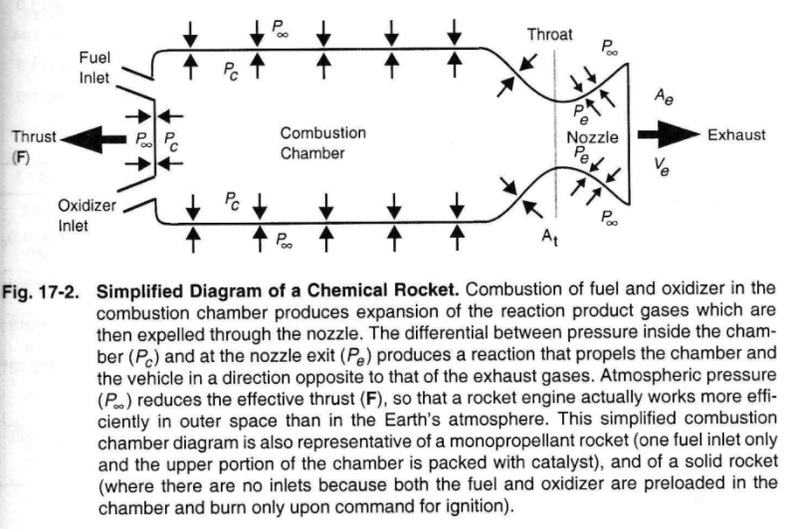

Slide 12
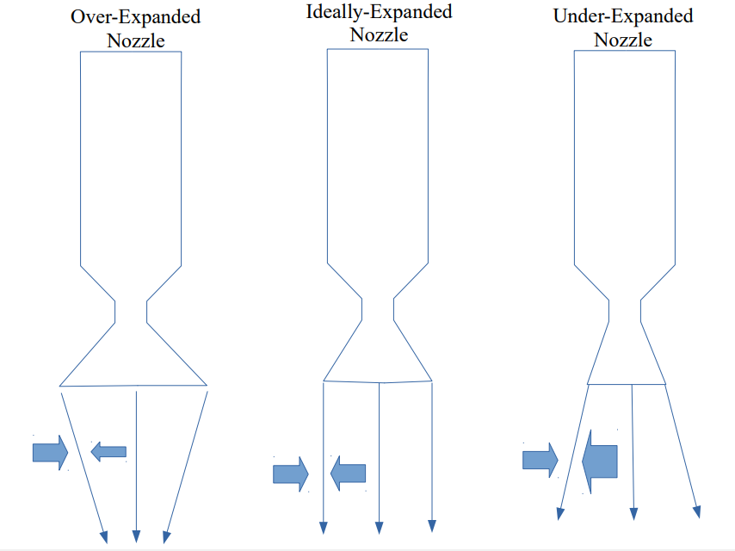
Nozzle Expansion
P_{atmos} > P_{exit}
P_{atmos} = P_{exit}
P_{atmos} < P_{exit}

Slide 13
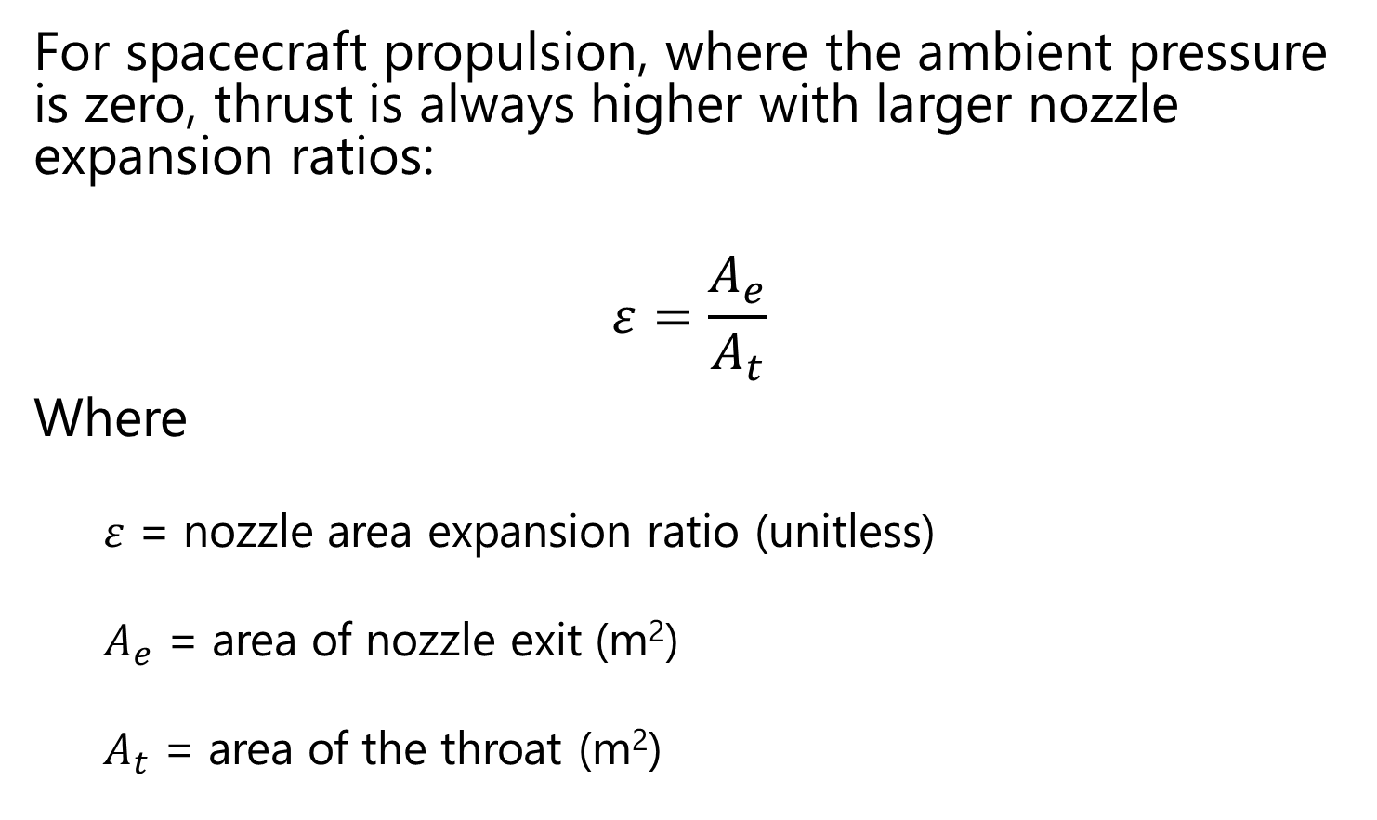
Nozzle Expansion
For spacecraft propulsion, where the ambient pressure is zero, thrust is always higher with larger nozzle expansion ratios:
$$ε=\frac{A_{e}}{A_{t}}$$
Where
$ε$ = nozzle area expansion ratio (unitless)
$A_{e}$ = area of nozzle exit (m²)
$A_{t}$ = area of the throat (m²)

Slide 14
Common Types of Spacecraft Propulsion (1/2)
Cold gas
Controlled, pressurized gas source with a nozzle
Simplest form of a rocket engine
Chemical
Liquid: stored as liquids in tanks and fed on demand into the combustion chamber by gas pressurization or a pump
Bipropellant: chemically react a fuel and an oxidizer
Higher specific impulse but additional complexity and cost
Monopropellant: catalytically decompose a single propellant
Solid: stores propellants in solid form
lower specific impulse, but simpler than liquid engines
Hybrid: propellants are stored in different forms; typically, fuel is solid and oxidizer is a liquid or gas
Attractive because of safety, allow for throttling and restart, fuel storability, environmentally clean

Slide 15
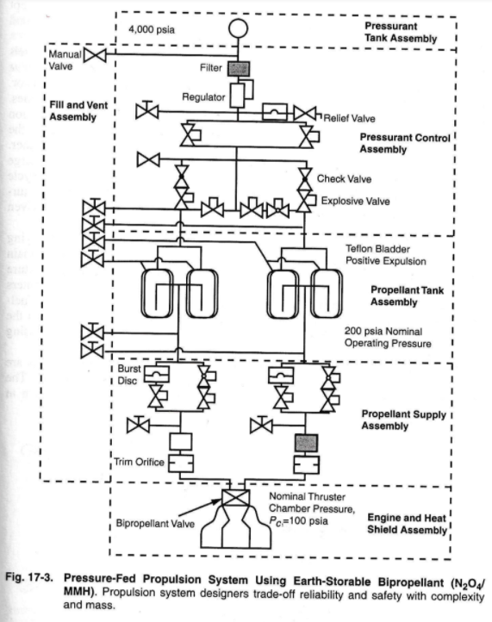
Liquid Bipropellant

Slide 16
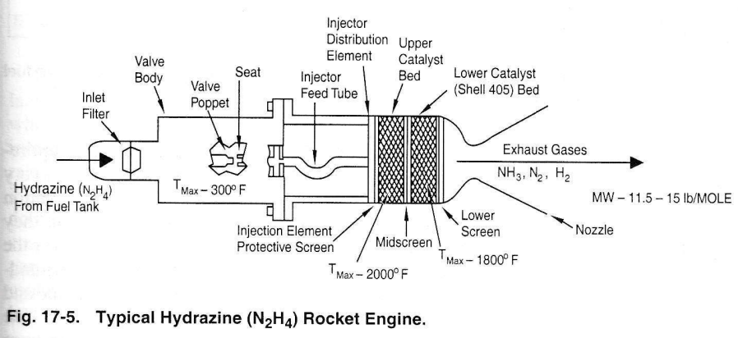
Liquid Monopropellant

Slide 17
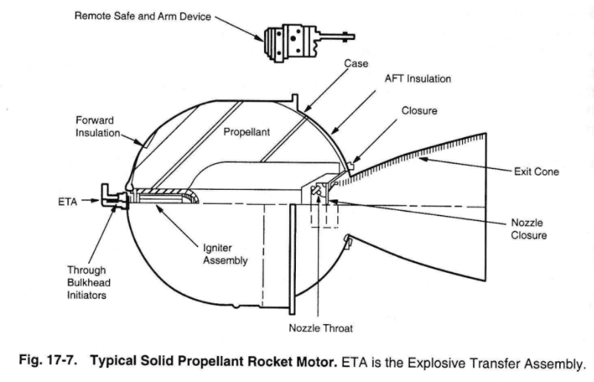
Solid

Slide 18
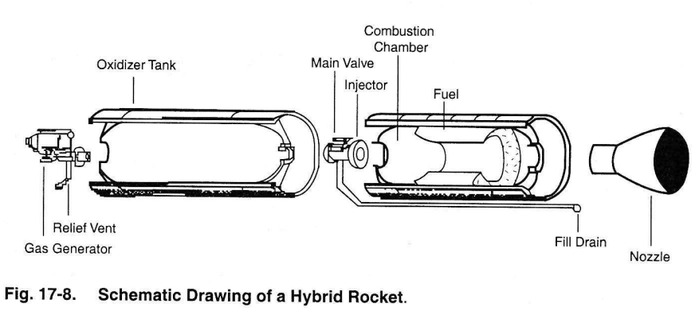
Hybrid

Slide 19
Common Types of Spacecraft Propellant (2/2)
Electric: produces thrust using externally provided electrical power either from Sun, nuclear, or thermodynamic conversion to accelerate fluid.
Electrothermal: gas heat via resistance element or arc and expanded through nozzle
Electrostatic: ions electrostatically accelerated
Electromagnetic: plasma accelerated via interaction of current and magnetic field

Slide 20
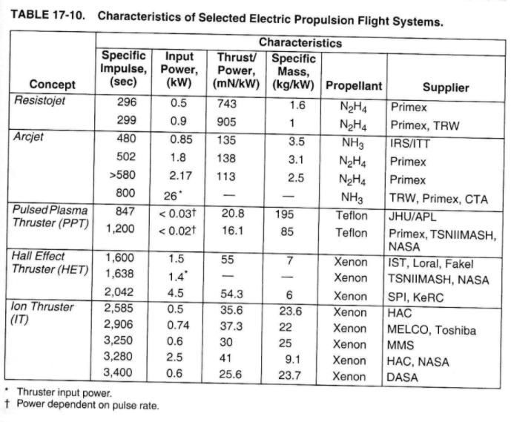
Electric Propulsion Comparison

Slide 21
Advanced Propulsion Concepts (gee-whiz)
Solar Sails – large sheets of thin reflective material, using photons to push the sail
Solar Thermal – use large solar reflectors to heat propellant in a “combustion” chamber
Nuclear Thermal – heat propellant in “combustion” chamber using a nuclear reactor

Slide 22
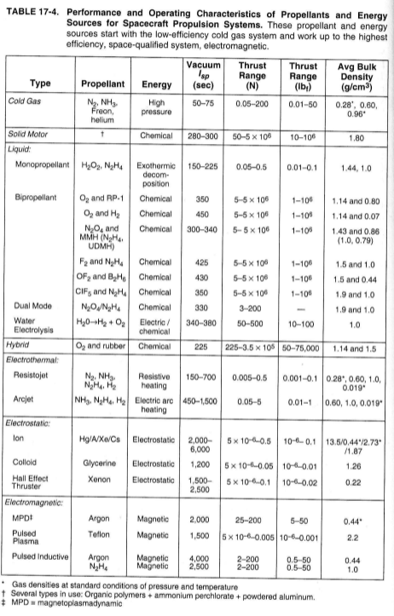
Performance Comparison of Different Propellants
Technology | Isp (sec) | Thrust (N)
Chemical | 140 – 450 | 0.1 – 12,000,000
Electric | 1000 – 10,000 | 0.0001 - 20
Nuclear | 800 – 1100 | Up to 12,000,000
Cold Gas | 60 - 250 | 0.1 - 50

Slide 23
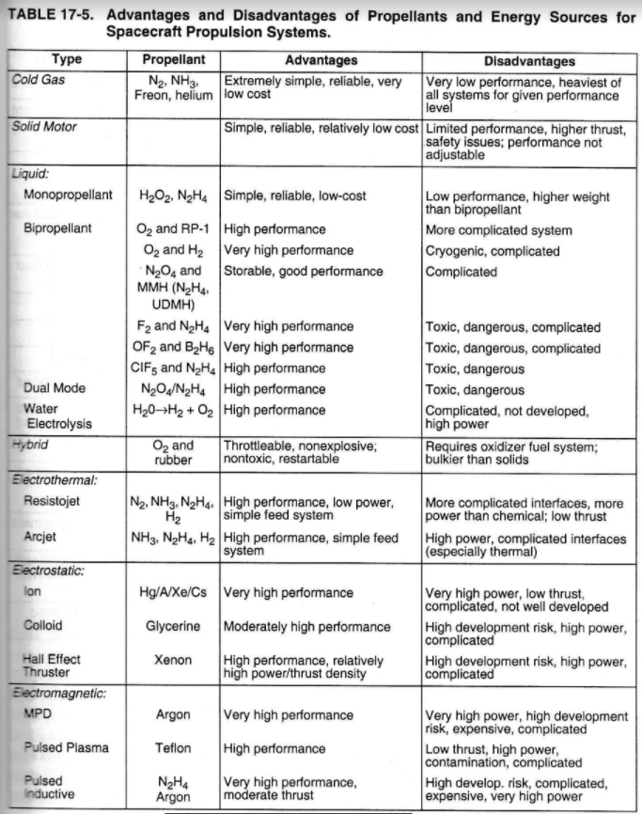
Advantages & Disadvantages
 | Pros | Cons
Chemical - Liquid | Higher Isp Throttleable Re-start able | Two propellants - complicated Intense combustion temps Sometimes cryogenic Sometimes toxic
Chemical - Solid | Simple Reliable No propellant management Higher Thrust-to-Weight | Cracks can form in propellant grain No restart Can’t stop Modest Isp
Electric | Simple Can achieve very high specific impulses No moving parts | Large amount of electrical power Low thrust
Nuclear | Long-term energy supply High Isp High thrust | Environmental issues Political issues No flight heritage
Cold Gas | Simplest Safest Restart able Throttleable | Low Isp

Slide 24
Propulsion Systems Suitability

Slide 25
Propellant Tank Sizing (1/3)
Calculate propellant volume using densities
(Table 17-4)
Add additional volume to account for ullage & possible shrinkage (an issue for cryogenic fuels)
Ullage: extra tank volume at the top of the tank to provide space for pressurization gas

Slide 26
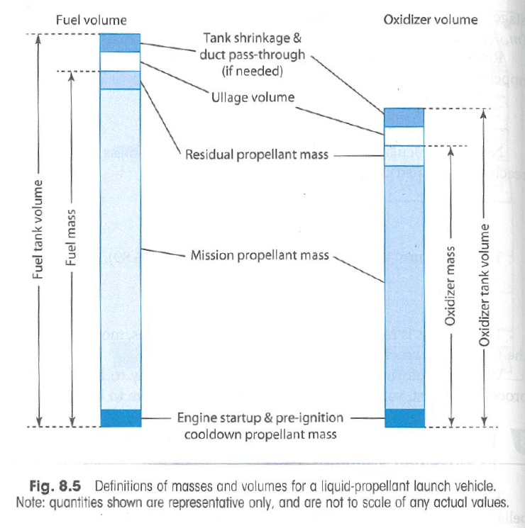

Slide 27
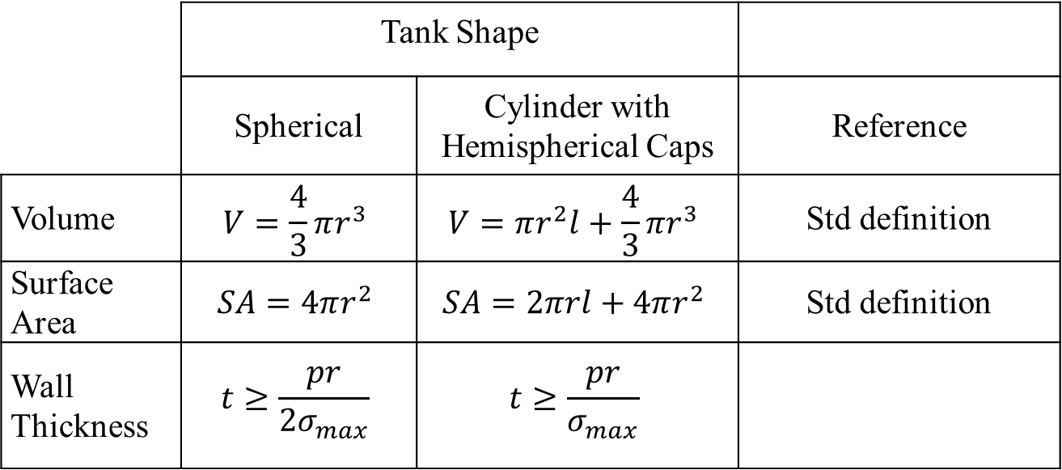
Calculate Tank Size (2/3)
(3) Select general tank geometry: solve for dimensions and mass
 | Tank Shape
 | Spherical | Cylinder with Hemispherical Caps | Reference
Volume | $$V=\frac{4}{3}πr^{3}$$ | $$V=πr^{2}l+\frac{4}{3}πr^{3}$$ | Std definition
Surface Area | $$SA=4πr^{2}$$ | $$SA=2πrl+4πr^{2}$$ | Std definition
Wall Thickness | $$t≥\frac{pr}{{2σ}_{max}}$$ | $$t≥\frac{pr}{σ_{max}}$$

Slide 28
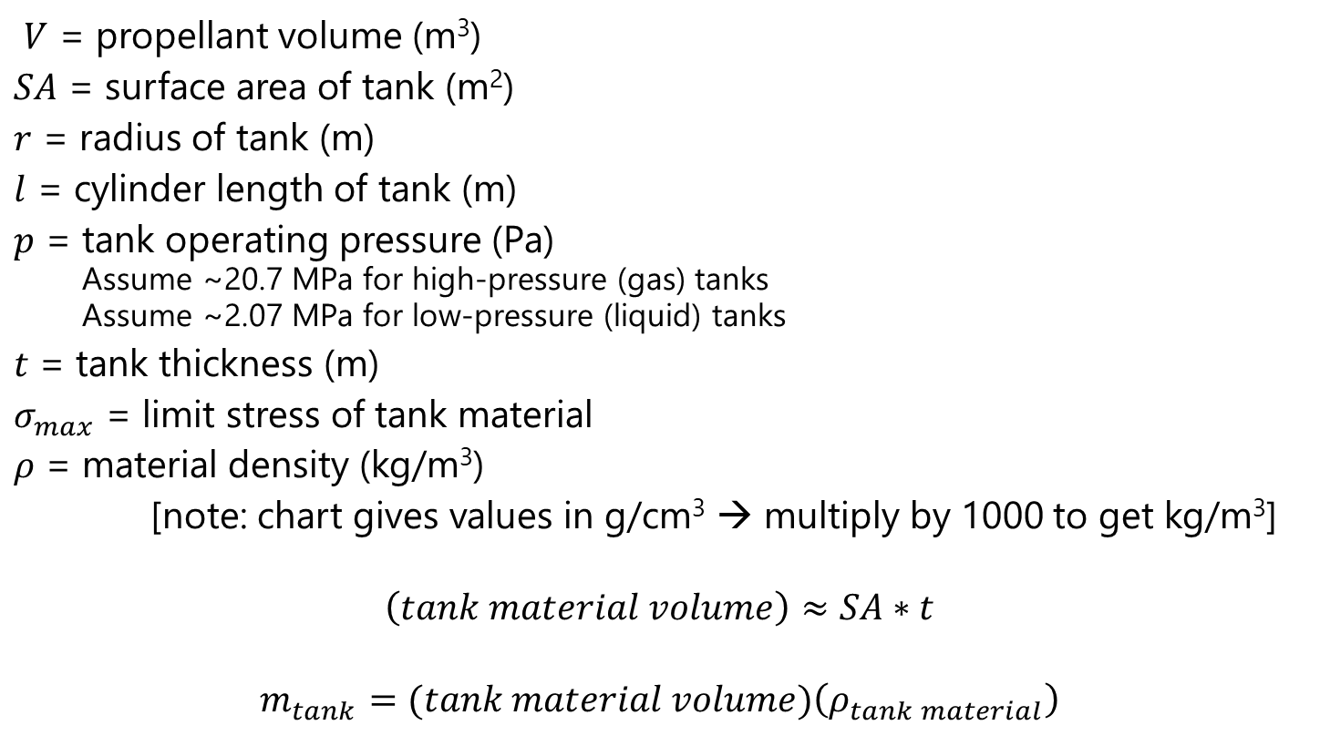
Calculate Tank Size (3/3)
$V$ = propellant volume (m³)
$SA$ = surface area of tank (m²)
$r$ = radius of tank (m)
$l$ = cylinder length of tank (m)
$p$ = tank operating pressure (Pa)
Assume ~20.7 MPa for high-pressure (gas) tanks
Assume ~2.07 MPa for low-pressure (liquid) tanks
$t$ = tank thickness (m)
$σ_{max}$ = limit stress of tank material
$ρ$ = material density (kg/m³)
[note: chart gives values in g/cm³ → multiply by 1000 to get kg/m³]
$$\left(tank material volume\right)≈SA∗t$$
$$m_{tank}=(tank material volume)\left(ρ_{tank material}\right)$$

Slide 29
LAUNCH SYSTEMS

Slide 30
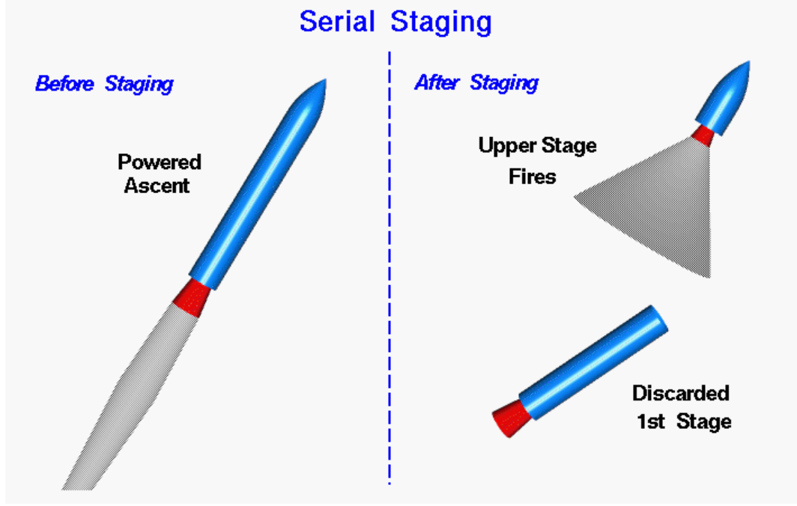
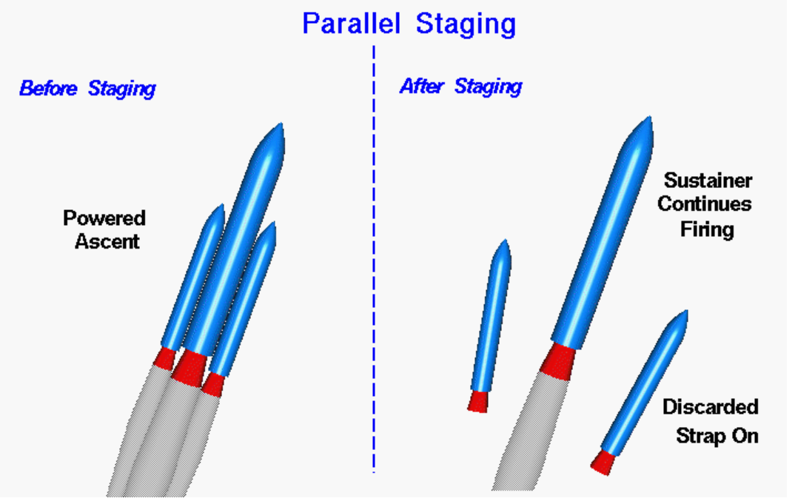
Launch Systems
Purpose: to accelerate and position spacecraft up to the velocity and location required for the payload’s desired trajectory
Staging: using multiple propulsive units which separate and are discarded after use to get to orbit
Why do we do staging?
B/c of the performance limitations on chemical propellants as well as the current state of the art in materials engineering and structural design, it is not practical to send a launch vehicle to orbit using a single propulsion system.

Slide 31
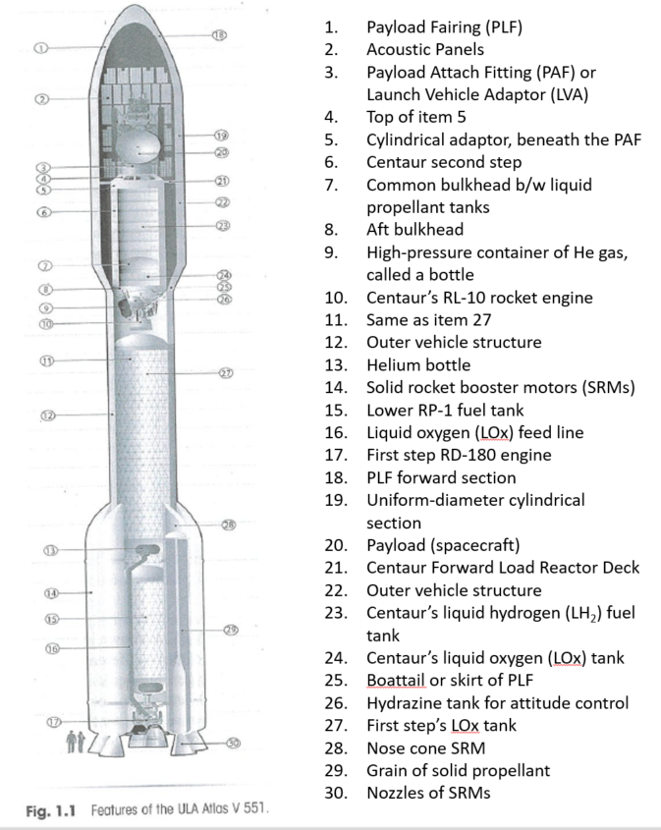

Slide 32
Payload Fairing (PLF)
Protects the payload from aerodynamic and heating loads as the LV climbs out of the atmosphere, keeps FOD away from payload, and serves as a container with a specially conditioned atmosphere to meet the payload’s thermal requirements
PLF is jettisoned once environment is safe for payload (above atmosphere)
Shock associated with the PLF jettison can be among the most significant transient design environment that a spacecraft must endure

Slide 33
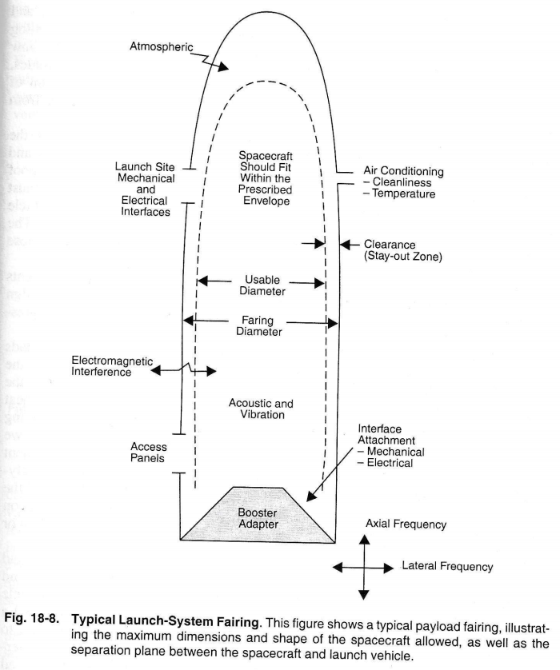

Slide 34
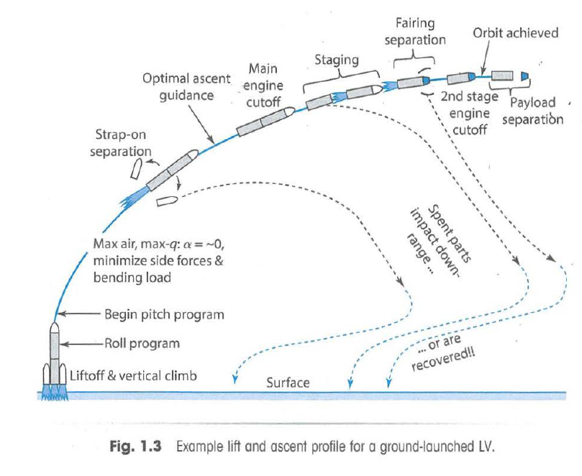

Slide 35
Maximum Dynamic Pressure
Max-Q (maximum dynamic pressure): point during ascent at which aerodynamic loads on vehicle are at highest
Sets maximum bending load values for vehicle (and payload)
Usually occurs just after vehicle passes Mach 1
Buffeting loads are also highest near Max-Q
Common for motors to be throttled back near Max-Q to reduce vehicle acceleration and loading
After Max-Q, the atmospheric density decreases faster than the vehicle’s speed increases, which causes the dynamic pressure to decrease

Slide 36
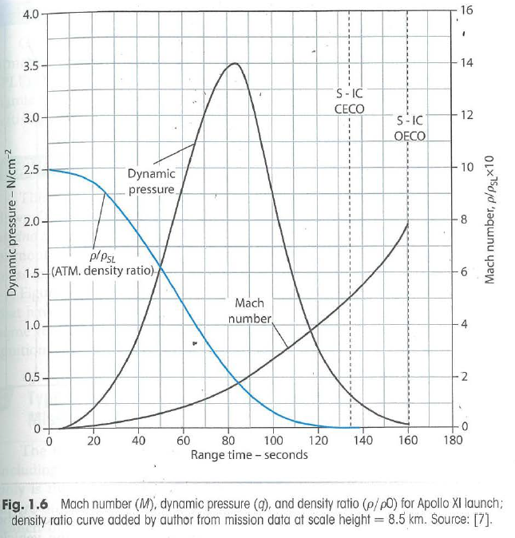

Slide 37
Loading Conditions during Launch & Ascent
Axial and lateral loading during liftoff
Vibrations during liftoff
Acoustic loading due to noise during liftoff & ascent
Pyrotechnic shock due to separation events

Slide 38
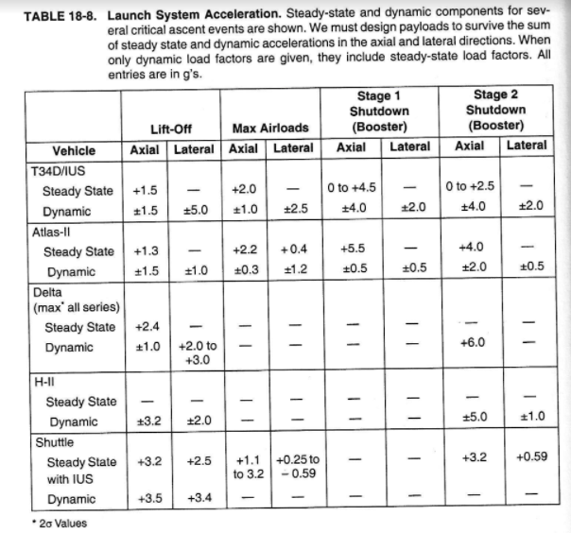

Slide 39
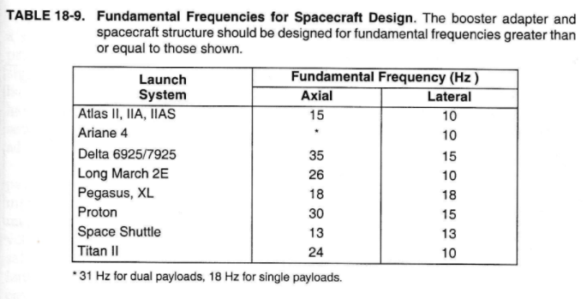

Slide 40
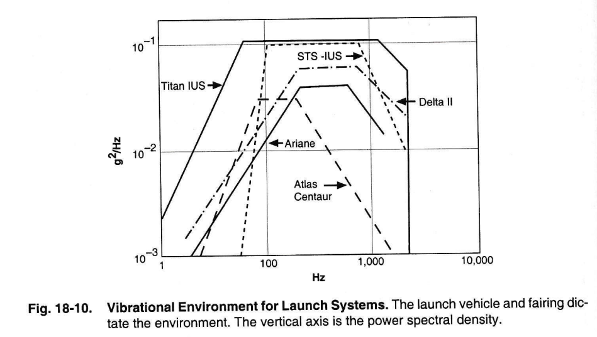

Slide 41
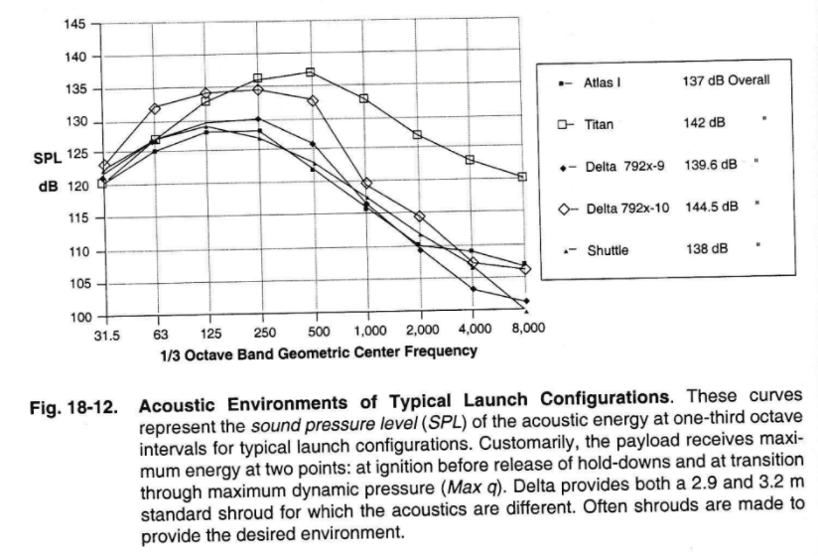

Slide 42
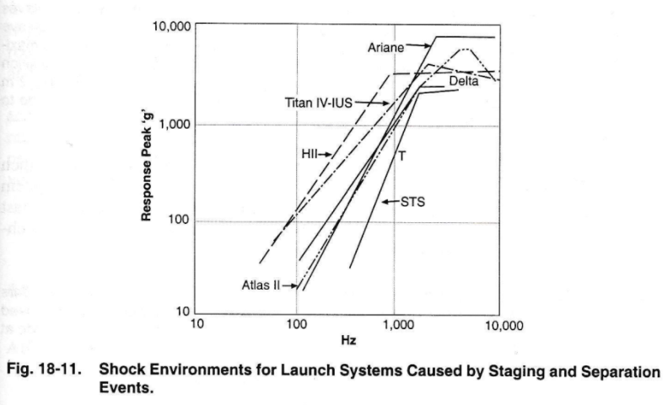

Slide 43
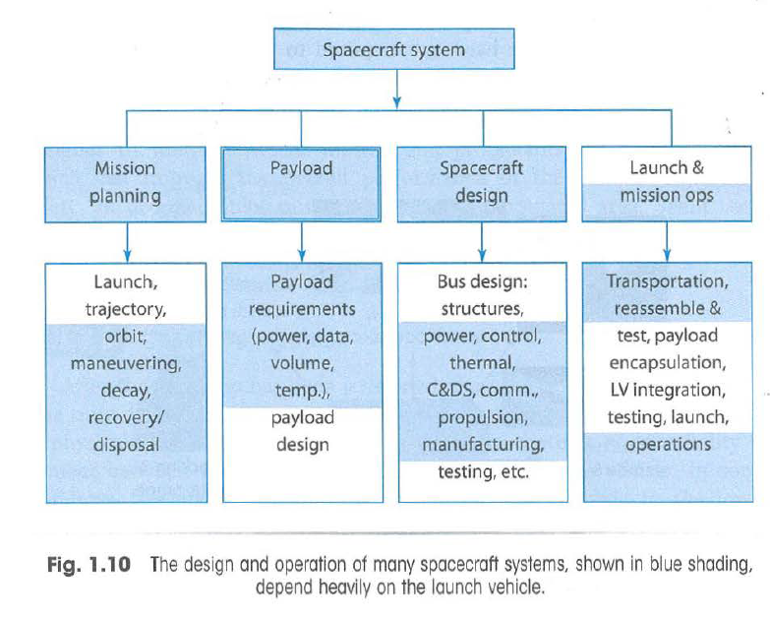

Slide 44
Launch Limitations
Recall that the latitude of the launch site must be less than or equal to the inclination of the orbit
Recall also that each launch site has allowable launch azimuths that must be met
Also need to consider transportation of spacecraft to launch site and weather at launch site during expected launch timeframe

Slide 45
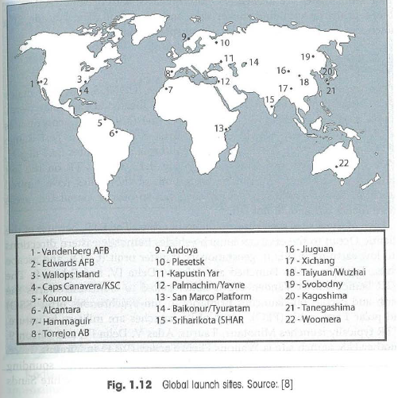

Slide 46
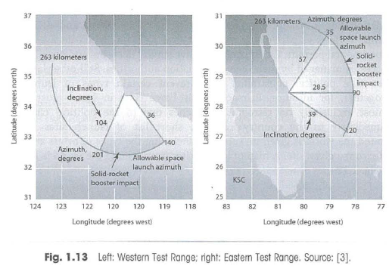

Slide 47
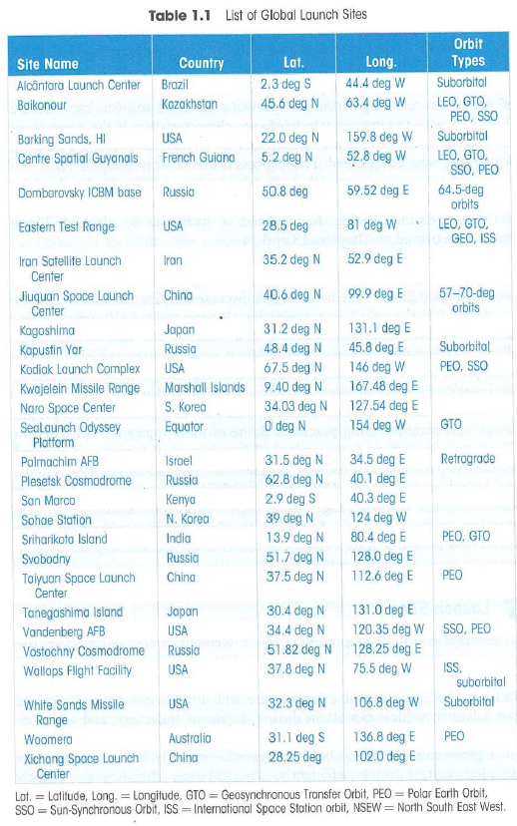

Slide 48
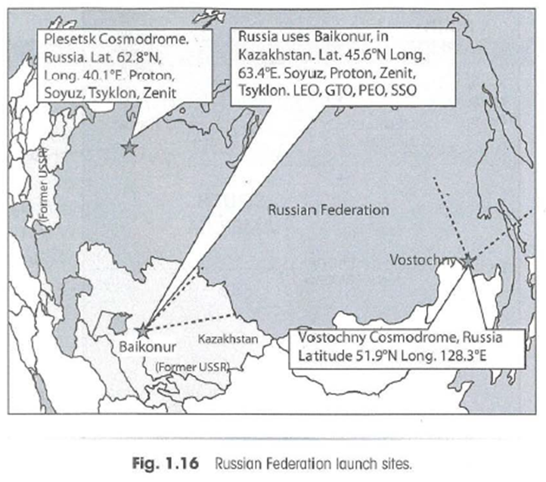

Slide 49
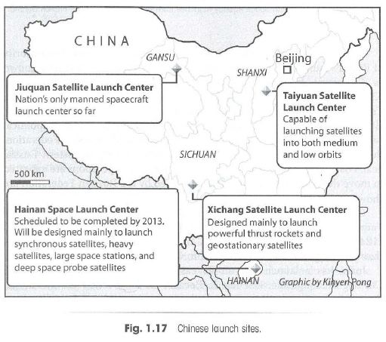

Slide 50
MISSION OPERATIONS

Slide 51
Space Mission Operations
Execute the mission and preserve the health and safety of the vehicle
Functions include:
Mission Planning: deciding what to do and when
Activity Planning & Development: creating operational scenarios and developing command loads
Mission Control: managing daily activities
Data Transport and Delivery: establishing communication links and managing data flow
Navigation and Orbit Control: determining where the spacecraft is and planning maneuvers
Spacecraft Ops: managing the spacecraft bus
Payload Ops: managing the spacecraft payload

Slide 52
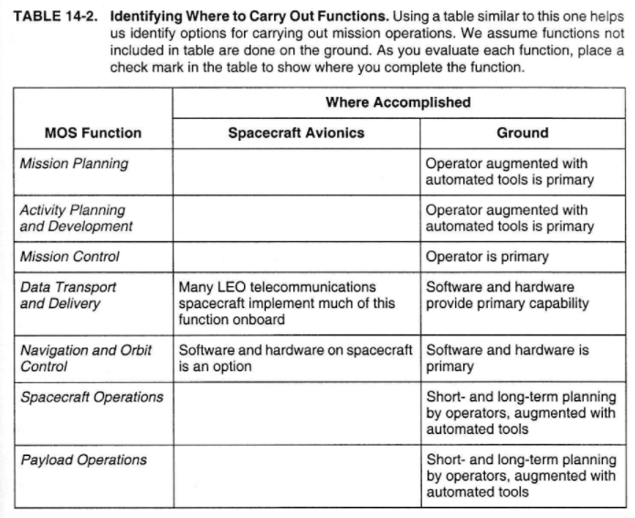

Slide 53
Mission Planning
Operations Plan: details the operations organization, processes and procedures to be followed by the operations team, the software tools that support them, and the interfaces between other teams (ie, spacecraft development team)
Best way to train operators it to involve them in the development and testing phases
Mission Plan: documents the planned spacecraft activities during the mission

Slide 54
Extra Material

Slide 55
Automation in Operations (1/2)
Many functions in space operations can be automated, either on-board the spacecraft or on the ground.
Monitoring alarms
Managing spacecraft resources
Analyzing performance and trends
Onboard navigation & orbit control
Adaptively planning activities
Processing payload data
Detecting faults, safing the vehicle
Constraint checking commands
Filtering/archiving data

Slide 56
Automation in Operations (2/2)
Advantages | Disadvantages
Reduced staffing = reduced operations cost | Potential to miss unexpected signatures
Reduced changes for operator error | Potential for fault response to be improper
Reduced response time to fault responses | Potential to misuse spacecraft resources
Potential to reduce data transmitted from spacecraft to ground | Potential to damage spacecraft
*Decision on how much and where to automate depends on risk posture, mission objectives and budget

Slide 57
Contingency Planning (1/2)
Identifying potential problems and a plan of action to mitigate impact if problem occurs
Not every problem can be anticipated, but the process of developing a contingency plan helps prepare the team to deal with problems when they occur
Prior to flight, identify anomaly response team – should have members of operations and development teams (and possibly other teams)
Prior to flight, the design and operations teams should work together to brainstorm every conceivable potential anomaly and for each case, develop operational responses
During flight, have development team members support operations

Slide 58
Contingency Planning (2/2)
In case of a failure:
Determine how much time is available before a decision is required
Make a timeline of events and include everything that is known
Give all team members all known facts and check every theory against them
Have multiple teams: some should investigate timeline replanning, others should work on hardware/software repair or workarounds
Make sure any deviation from the norm is explained—remember, the wrong conclusion is prologue to the next failure
Do not arrive at a conclusion too rapidly
Know when to stop trying to force-fit a scenario

